Slide 1
An Introduction To Bayesian Statistics
Simon Thornewill von Essen
Data Analyst, Goodgame Studios
@sthornewillve 🐍

Slide 2
How do we estimate probability?
Classical: By considering equal outcomes
Frequentist: Relative Frequency over time
Bayesian: By quantifying our uncertainties

Slide 3
Coin Toss: Classical Est.
Coin
|
------
| |
H T
0.5 0.5

Slide 4
Dice: Classical Est.
Dice
|
--------------------------
| | | | | |
1 2 3 4 5 6
0.16 0.16 0.16 0.16 0.16 0.16

Slide 5
Classical Stats
Requirements
All Outcomes are known
Outcomes are assumed to be equally likely
Advantages
Fast Estimation
Easy to understand
Disadvantages
Outcomes must be known
Often created overly simplified models when applied to complex phenomena

Slide 6
How do we estimate probability?
Classical
Frequentist
Take measurements over time
Measurements will eventually approximate the parameter we want to measure
Bayesian

Slide 7
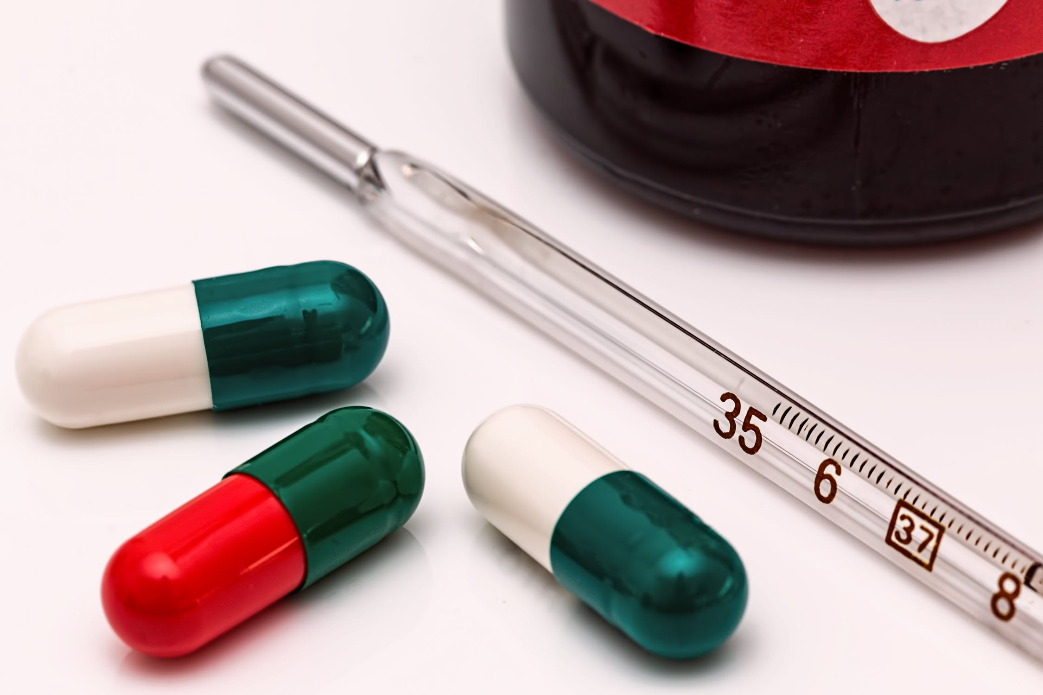
Thermometer Calibration: Frequentist Est.
Check to see if thermometer is properly calibrated
Frequentist Approach:
Take many readings and use the expectation value (mean) and std for sample
Calculate the probability of your data given your data following some parameter.

Slide 8

Thermometer Calibration: Frequentist Est.
Confidence Interval:
From sample mean and standard deviation, calculate an interval
Interval contains the true parameter x% of the time upon repeated experiments

Slide 9
Thermometer Calibration: Frequentist Est.
Confidence Interval:
Intuition:
If you were to bootstrap the confidence interval n times
Interval would contain the mean of population 95% of the time

Slide 10
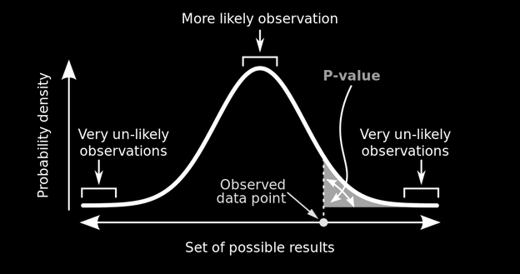
Probability of Rain: Frequentist Est.
P-value:
Probability of data given a parameter
“The probability that outcome is due to random chance given that there is no difference between experimental groups”
P(X | μ)

Slide 11
Thermometer Calibration: Test
If P-value = 0.001 (highly significant), is the probability of getting this result given our data 0.001?
❌
2. For a given confidence interval, does the parameter lie within it 95% of the time?
❌

Slide 12
Thermometer Calibration: Test
If P-value = 0.001 (highly significant), is the probability of getting this result given our data 0.001? Probability of getting this result given no difference in experimental groups is 0.001
2. For a given confidence interval, does the parameter lie within it 95% of the time? Intervals of repeated experiments will contain the parameter 95% of the time

Slide 13
Thermometer Calibration: Test Learnings
Frequentism expects that parameters exist and are fixed, the probabilities are the likelihood of our data given these expectations
Repeated Experiments
Mean

Slide 14
“Wait, wasn’t this was we were doing with frequentism?”
Repeated Experiments
Given a region
Our parameter will be more or less likely
Mean
Example from J. Vanderplas’s 2014 Scipy Talk

Slide 15

Thermometer Calibration: Test Learnings
Child doesn’t move, your repeated photos contain them 95% of the time

Slide 16
Frequentist Stats
Requirements
Possibility to perform experiments indefinitely
Parameters are assumed to be fixed
Able to estimate params given enough experiments
Advantages
Works well with simulations
“Objective”
Disadvantages
Requires large sample size to be meaningful
Does not allow for integration of domain knowledge
P-values and confidence intervals are unintuitive
Difficult to communicate to non-statisticians

Slide 17
Frequentist Stats Disav. Cont.
What if?
Amount of data you have is limited?
You have relevant and applicable prior information
“Infinite” experiments are not possible? (Cost, feasibility)
Stakeholders have a hard time understanding frequentist logic?
Children never stay still and assuming they do is blasphemy
✔️
✔️
✔️
✔️
✔️

Slide 18
How do we estimate probability?
Classical
Frequentist
Bayesian

Slide 19
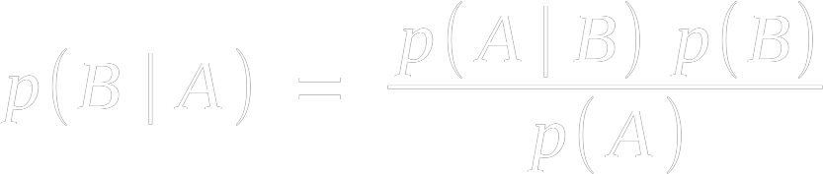
Bayes Theorem
Goal: Invert a likelihood
likelihood
prior
posterior
normalisation

Slide 20
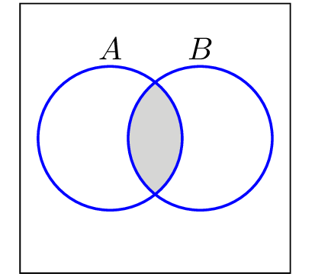

Bayes Theorem: Derivation

Slide 21

Bayes Theorem: Derivation
The Same
∴

Slide 22

Bayes Theorem: Alternate View
𝜃 = Parameter,
X = Data

Slide 23
Bayes Theorem: Alternate View
✔️
Problem:
How to calculate p(X)
How to calculate p(𝜃)

Slide 24
Bayes Theorem: How to Calculate P(𝜃)?
Create Your Own
Take Previous posterior

Slide 25

Bayes Theorem: How to Calculate P(𝜃)?
Problem: Are you Baking your biases into your model?
Notes:
Making Biases explicit
With enough data, bayesian and frequentist likelihoods are equivalent such that priors are “washed out”

Slide 26
Bayes Theorem: How to Calculate P(𝜃)?
Might as well have your explicit and tangible biases.
As the sample size increases, priors get washed out.
Low Sample Size: Frequentist Stats is börked anyway, so why not?
High Sample Size: Prior Doesn’t matter
Notes:
Making Biases explicit
With enough data, bayesian and frequentist likelihoods are equivalent such that priors are “washed out”

Slide 27


Bayes Theorem: How to Calculate P(X)?
Sum of all possible numerators
Yes, this can get difficult

Slide 28
Bayes Theorem: How to Calculate P(X)?
You can ignore P(X) if you are comparing posteriors for the same distributions

Slide 29
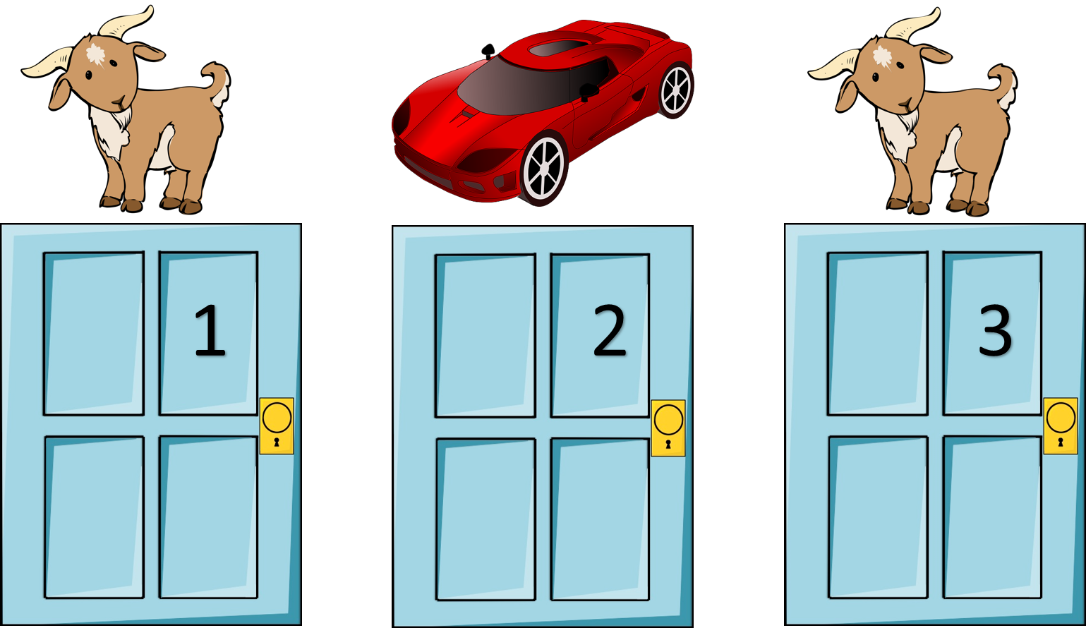
How!?: Monty Hall Problem
The Monty Hall Problem:
You Pick Door 1
Monty opens door 2 to reveal a goat
Should you switch to door 3?

Slide 30
How!?: Monty Hall Problem
Hypothesis i | Prior p(𝜃_{i})
Car Behind 1 | 1/3
Car Behind 2 | 1/3
Car Behind 3 | 1/3

Slide 31
How!?: Monty Hall Problem
Hypothesis i | Prior p(𝜃_{i}) | Likelihood p(X | 𝜃_{i})
Car Behind 1 | 1/3 | 1/2
Car Behind 2 | 1/3 | 0.0
Car Behind 3 | 1/3 | 1.0

Slide 32

How!?: Monty Hall Problem
Hypothesis i | Prior p(𝜃_{i}) | Likelihood p(X | 𝜃_{i}) | Prior * Likelihood
Car Behind 1 | 1/3 | 1/2 | 1/6
Car Behind 2 | 1/3 | 0.0 | 0.0
Car Behind 3 | 1/3 | 1.0 | 1/3
= 1/6 + 0 + 2/6
= 3/6
= 1/2
* This is the Dot Product of p(𝜃_{i}) and p(X | 𝜃_{i})

Slide 33
How!?: Monty Hall Problem
Hypothesis i | Prior p(𝜃_{i}) | Likelihood p(X | 𝜃_{i}) | Prior * Likelihood | Posterior
Car Behind 1 | 1/3 | 1/2 | 1/6 | 1/3
Car Behind 2 | 1/3 | 0.0 | 0.0 | 0
Car Behind 3 | 1/3 | 1.0 | 1/3 | 2/3
Key to problem:
Monty does not choose doors at random and so opening a door provides you with information
“Table Method” from A. Downey’s Think Bayes

Slide 34
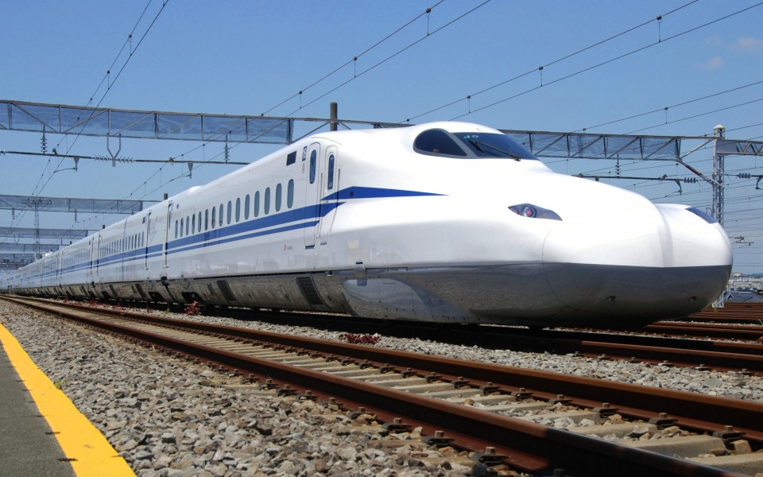
How!?: Train Analysis
You see a train labeled 60
What was the probability of seeing 60 given that you saw it?

Slide 35
How!?: Train Analysis
Hypothesis i | Prior p(𝜃_{i}) | Likelihood p(X | 𝜃_{i}) | Prior * Likelihood | Posterior
1 Train | 1/N | 0.0 | 0.0 | post₁
2 Trains | 1/N | 0.0 | 0.0 | post₂
... | ... | ... | ... | ...
60 Trains | 1/1000 | 1/60 | 1/(6*10⁴) | post₆₀
... | ... | ... | ... | ...
1000 Trains | 1/1000 | 1/1000 | 1/10⁶ | post₁₀₀₀
𝚺 = P(Train)

Slide 36
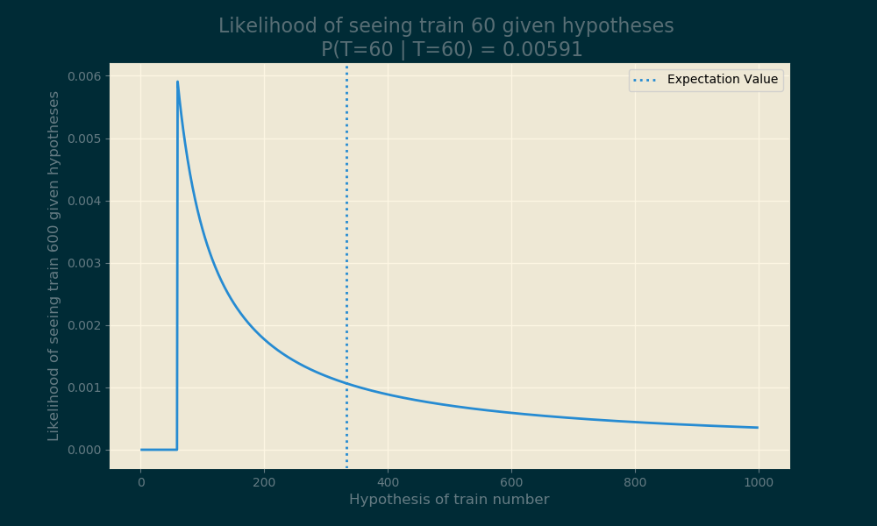
How!?: Train Analysis

Slide 37
How!?: Train Analysis
What if we change priors?
Posterior changes
What if we increase the max number of trains
Posterior changes
Example from A. Downey’s “Think Bayes”

Slide 38

How!?: Part 1 - Discrete Case Recap
Remember the table calculation!
Steps:
Pick Prior (Often Uniform)
Multiply by Frequentist Likelihood
Divide by Normalisation constant

Slide 39
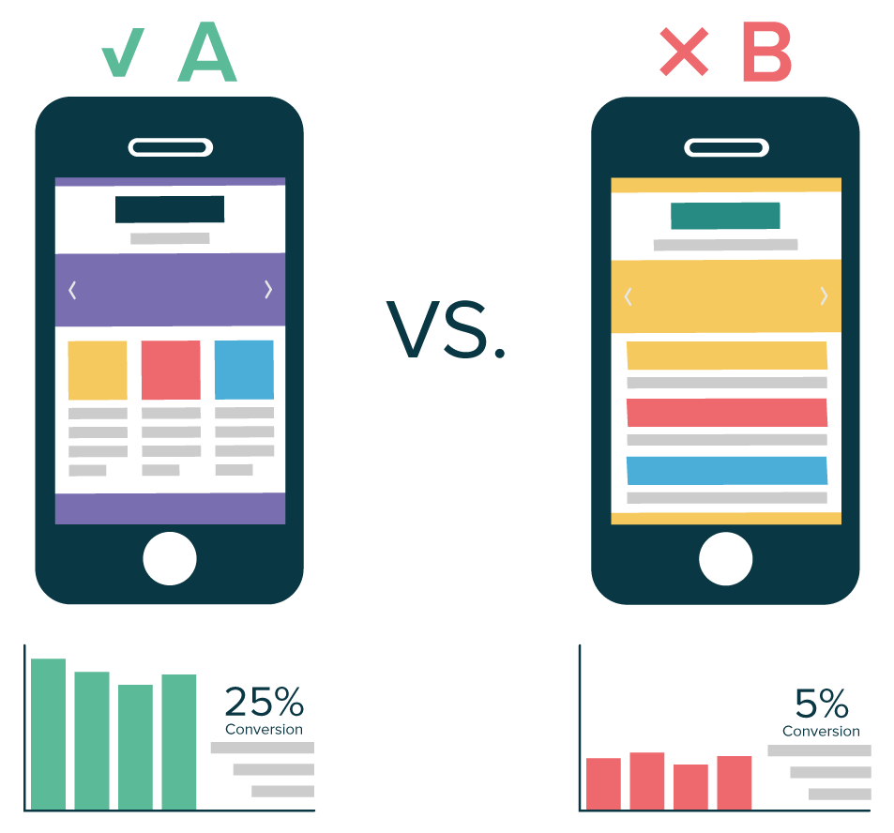
How!?: Part 2 - Continuous Case
AB Testing Revisited:
Two variants
What is the probability of A being better than B?
Time for Bayesian Statistics!

Slide 40

How!?: Part 2 - Continuous Case
AB Test:
For people randomly placed in control/test
Track conversions (1/0)
What is our Likelihood?
Bernoulli

Slide 41

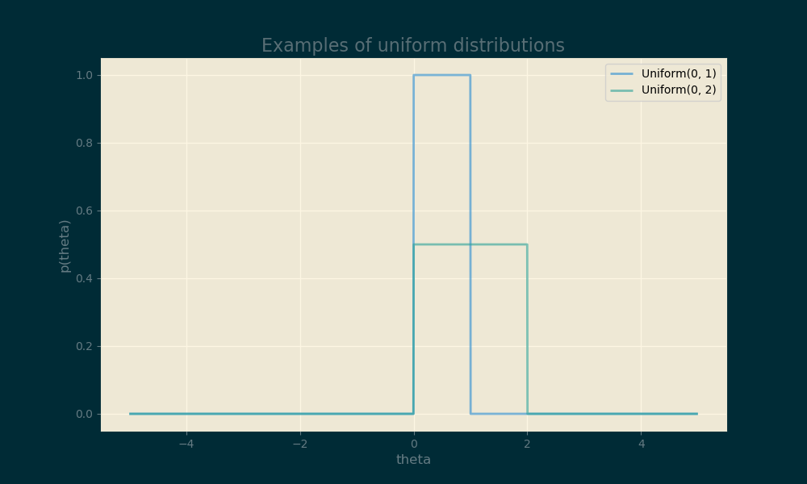
How!?: Part 2 - Continuous Case
Prior?:
Uninformed Prior
Uniform distribution
Represented by Indicator Function

Slide 42
How!?: Part 2 - Continuous Case
Notes:
Quick and Dirty: Multiply Prior by Likelihood

Slide 43

How!?: Part 2 - Continuous Case
Notes:
For accurate, divide by the likelihood of the data at each point
Integral is gnarly, but we can make it equal to 1 to make it disappear

Slide 44


How!?: Part 2 - Continuous Case
Notes:
Make integral equal to one by adding A coefficient

Slide 45

How!?: Part 2 - Continuous Case
Notes:
Equation simplifies massively

Slide 46


How!?: Part 2 - Continuous Case
Notes:
Et Voila. A function that is easy to import from numpy

Slide 47

How!?: Part 2 - Continuous Case Recap
Steps:
Pick Prior (Often Uniform)
Multiply by Frequentist Likelihood
Divide by Normalisation constant
Integral over all possible hypotheses
(Tips and tricks may be required)

Slide 48
When is it okay not to perform Normalisation?
When you are comparing two values inside of the same set that creates p(P)

Slide 49
Conjugate Priors
Beta distribution is example of conj. Prior
Use it and you will get the same distribution in posterior
Once the math is done, never do it again
Update functions using data as it appears
See more Conj. Priors in U. of Santa Cruz’s Coursera Course

Slide 50
Conjugate Priors
https://en.wikipedia.org/wiki/Conjugate_prior#Table_of_conjugate_distributions
(Just Google “conjugate priors table wikipedia”)

Slide 51
Conjugate Priors
https://en.wikipedia.org/wiki/Conjugate_prior#Table_of_conjugate_distributions
(Just Google “conjugate priors table wikipedia”)

Slide 52
Posteriors - What Now?
Estimation of Parameters
Credible Intervals
Vary priors to see effects
Calculate P(𝛳=x | X)
etc.

Slide 53
Demo:
Conjugate Priors

Slide 54
Posteriors - What Now?
Challenges w/ Freq. AB Tests:
Test needs to reach pre-defined sample size
Need to adjust α for multiple tests (Bonferroni Corrections)
People start accepting null hypotheses
Can only reject/fail to reject null hypothesis, (leads to p-hacking)
People peek at tests before tests are over, (moar p-hacking)

Slide 55
Posteriors - What Now?
Do we calculate P-values now?
No need, just calculate P(𝜃₂ > 𝜃₁)
Takes some calculation, but the result is nicer
Can we peek or stop at any time?
Yes!
More from Nora Neumann @ Pydata 2016 on YouTube

Slide 56
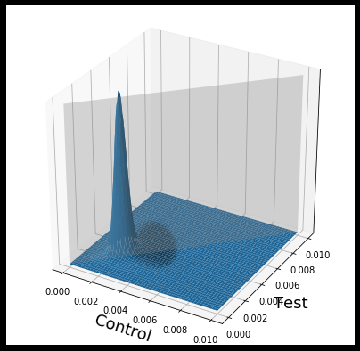
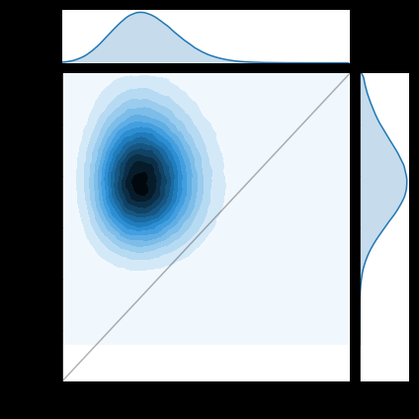
Posteriors - What Now?
More from Vincenzo Lavorini @ “Bayesian A/B Testing with Python: the easy guide” Towards Data Science

Slide 57
Bayesian Stats
Advantages
Incorporation of Domain Knowledge
Estimation in the case of little data (specific circumstances)
Allows for models of as little or high complexity as necessary
Parameters are distributions
Easier to communicate with more interpretable answers
Disadvantages
Lots and lots of theory
Integrals are hard, MCMC methods aren’t easy either
MCMC can be computationally expensive
Criticisms of being less “objective” due to use of priors
Point estimates become the same as frequentist estimations with high sample sizes

Slide 58
How do we estimate probability?
Classical: By considering equal outcomes
Frequentist: Relative Frequency over time
Bayesian: By quantifying our uncertainties

Slide 59
Conclusion and “Call to Action”
Understanding Bayes vs Freq. is key to understanding a lot of stats
For scientists: Check my sources as a jump off point
For decision-makers: Consider these kinds of analyses when little data is available

Slide 60
Resources for further learning
Mathematical Understanding: “Bayesian Stats: From Concept to Data Analysis”, U of Santa Cruz
Intuition between Bayesianism & Frequentism: “Frequentism and Bayesianism”, Scipy - Jake Vander Plas
Examples of Real World Applications: “Think Bayes”, Allan Downey
Further reading into MCMC and pyMC: “Bayesian Methods for Hackers”, Cameron Davidson-Pilon

Slide 61
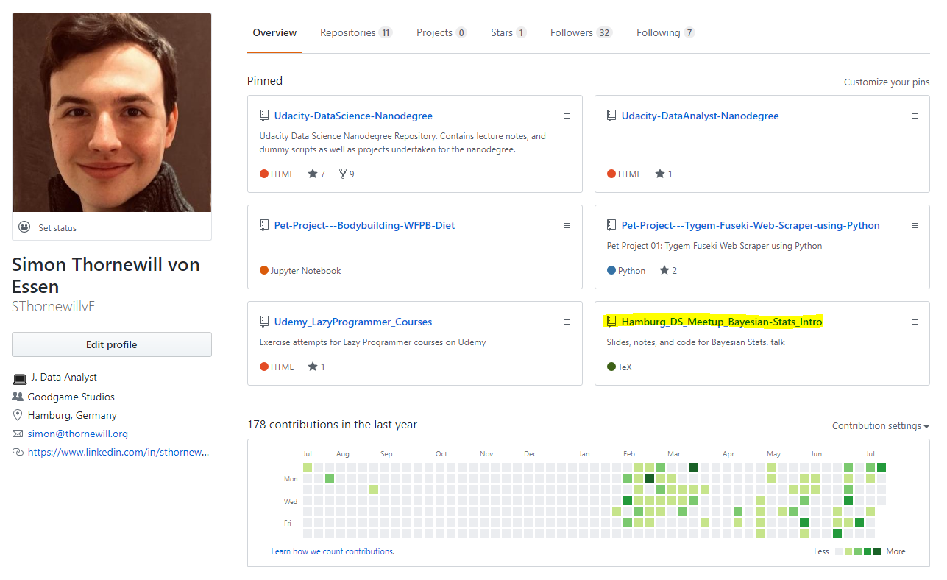

Find Slides on Github
https://cutt.ly/zGqux9

Slide 62
Fin!
@sthornewillve

